Slide 1
Combining Sketch and Tone for Pencil Drawing Production
NPAR, 2012.(Best Paper Award)

Slide 2
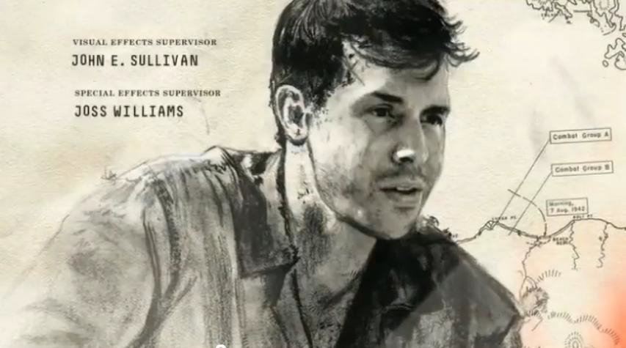
Episode of <The Pacific>

Slide 3
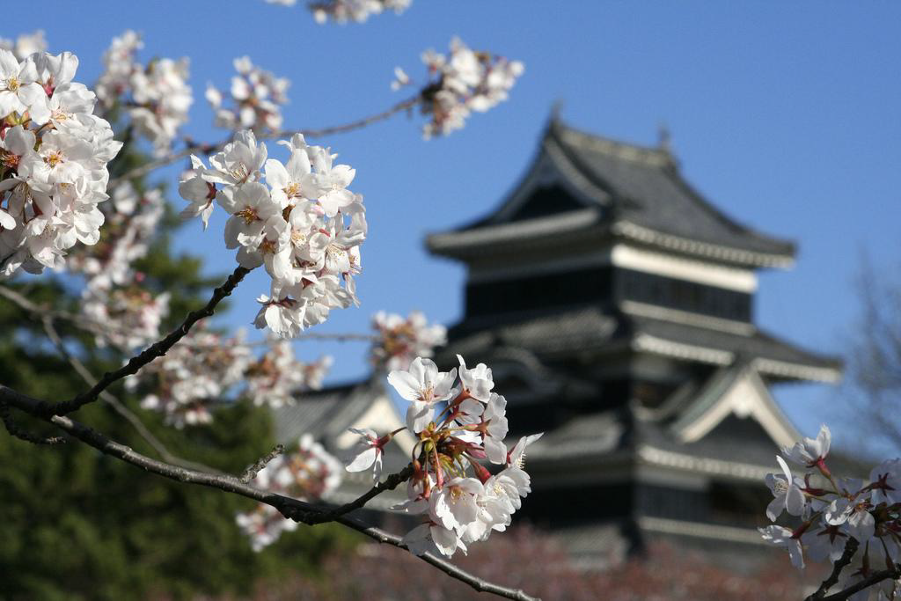

Slide 4
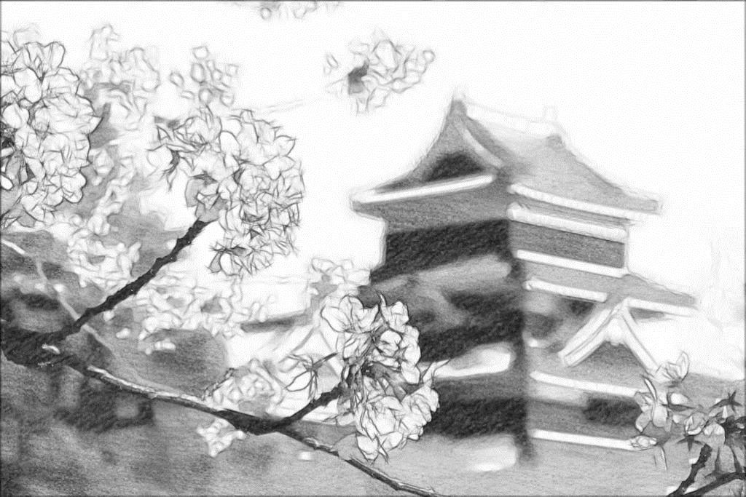

Slide 5
Outline
Previous work
Observation (Two stages)
Framework (Pencil drawing prior included)
More Results
Color Pencil Drawing

Slide 6
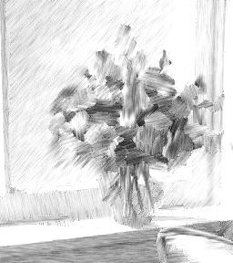
Previous Work (Image-based)
Li and Huang 2003
Gao et al. 2010
Sun et al. 2007

Slide 7
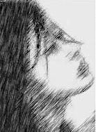
Previous Work (Image-based)
Li and Huang 2003
Gao et al. 2010
Sun et al. 2007

Slide 8
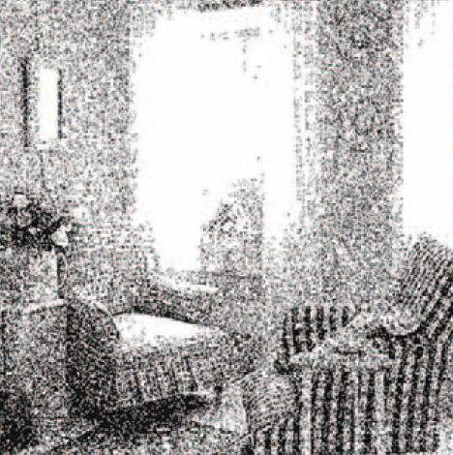
Previous Work (Image-based)
Li and Huang 2003
Gao et al. 2010
Sun et al. 2007

Slide 9
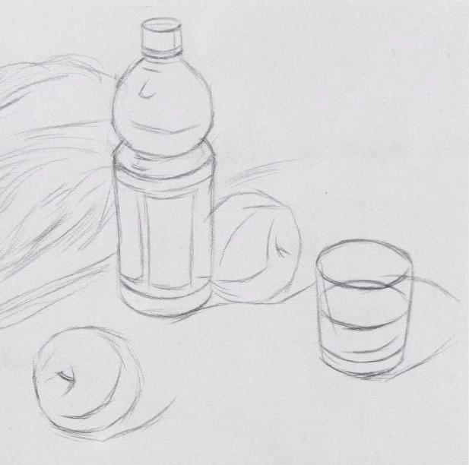
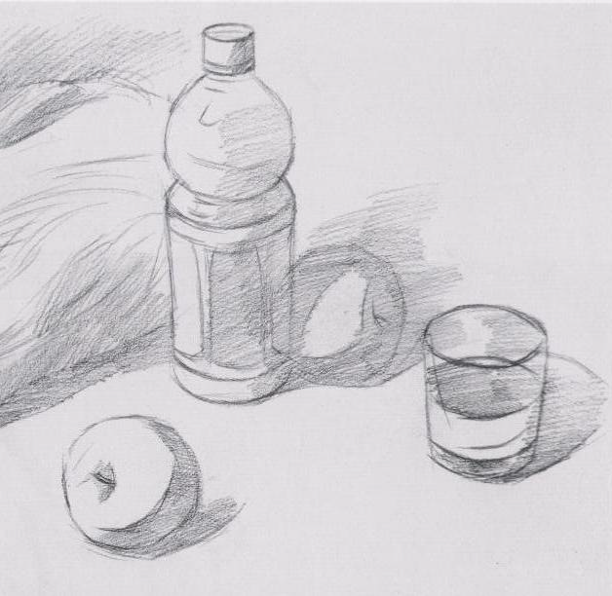
Observation
First Stage
Second Stage
Human Drawing Procedure

Slide 10
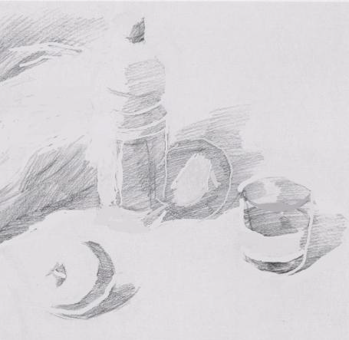
Observation
Structure
Tone

Slide 11
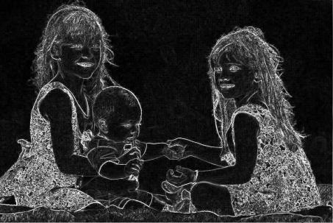
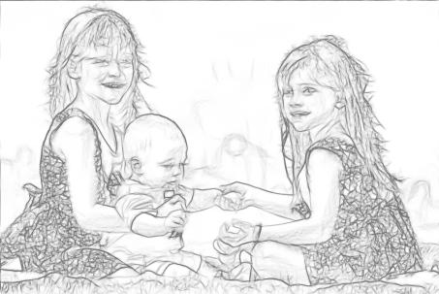
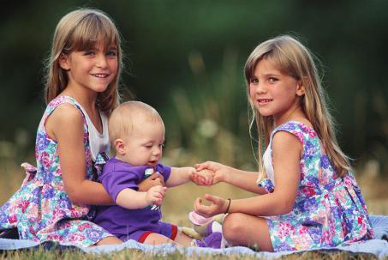
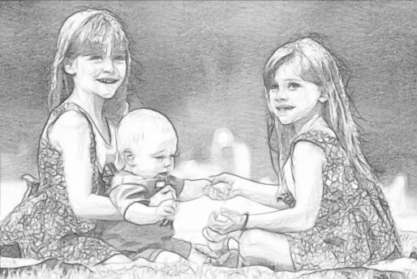
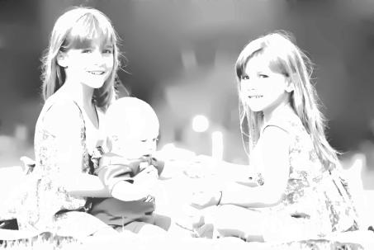
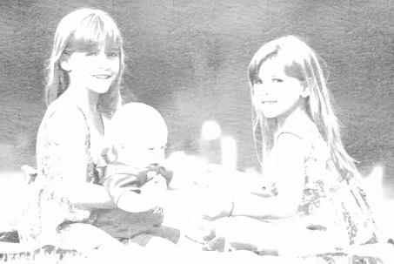
Framework
Gradient
Line Drawing
Tone Mapping
Texture Rendering

Slide 12
Framework(Line Drawing)
Gradient
Line Drawing
Tone Mapping
Texture Rendering

Slide 13
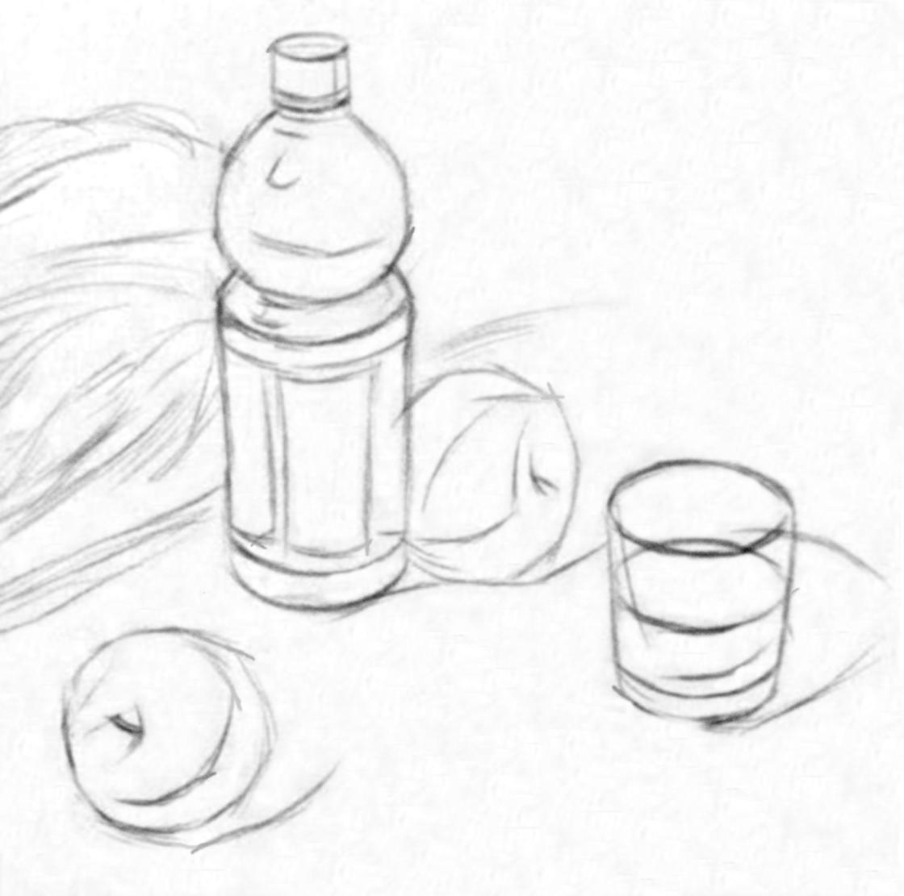
Framework(Line Drawing)

Slide 14
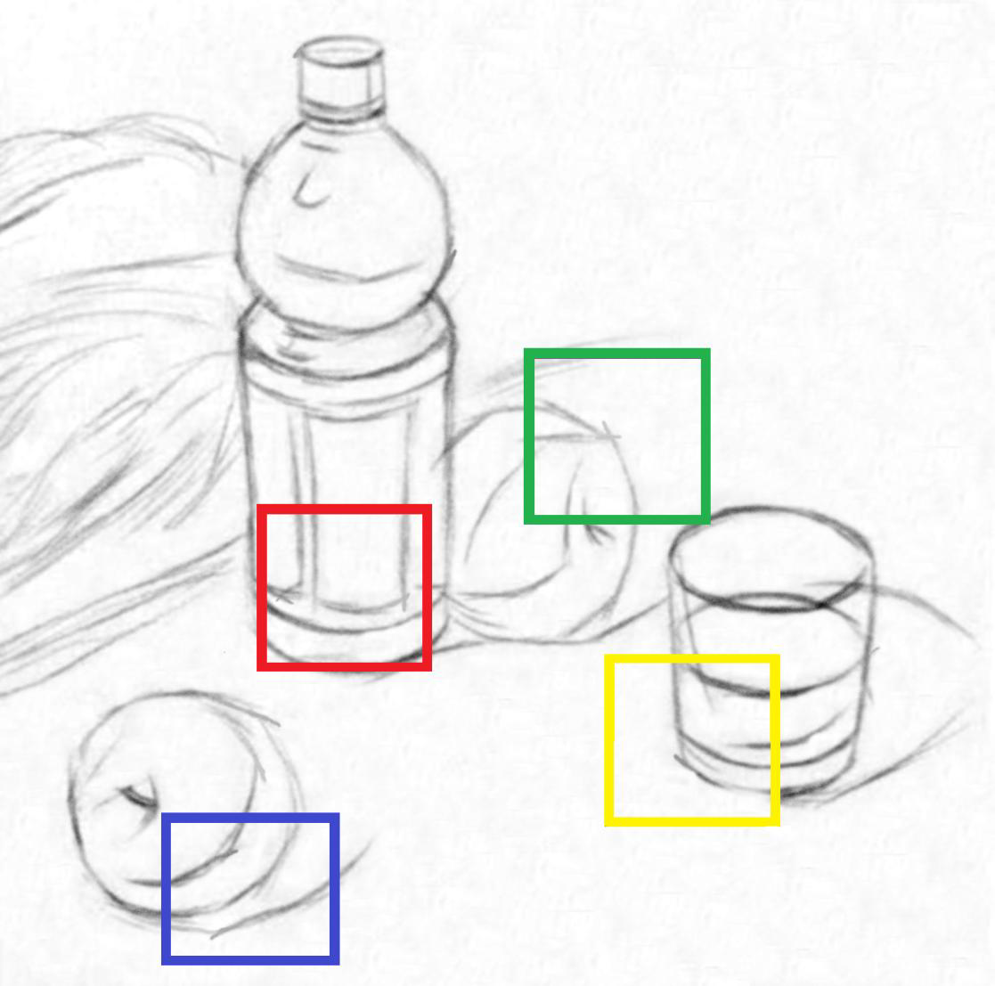
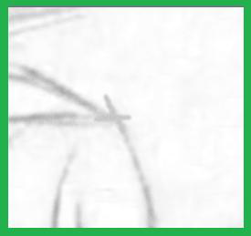
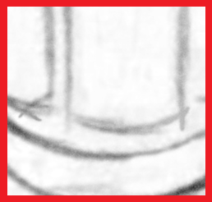
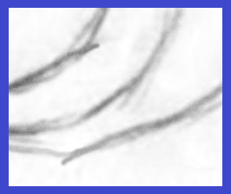
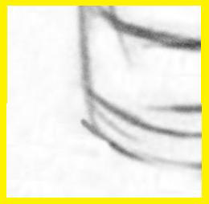
Framework(Line Drawing)

Slide 15
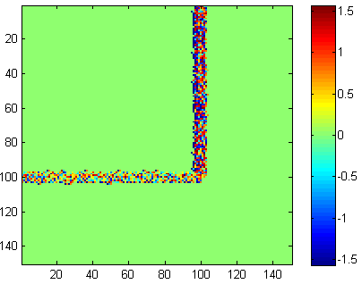
Framework(Line Drawing)
A Naive method
Pixel Direction

Slide 16
Framework(Line Drawing)
A Naive method
Extent along their Direction

Slide 17
Framework(Line Drawing)
Proposed Edges Direction Classification
$$C_{1 }$$
$$C_{2}$$

Slide 18
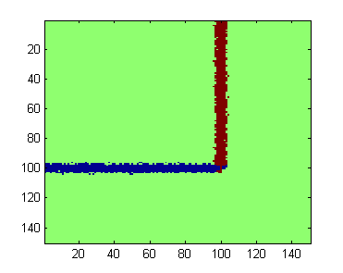
Framework(Line Drawing)
Proposed Edges Direction Classification
$$C_{1 }$$
$argmax\left\{C_{1},C_{2}\right\}=1$
red
$argmax\left\{C_{1},C_{2}\right\}=2$
$$C_{2}$$
blue

Slide 19
Framework(Line Drawing)

Slide 20
Framework(Line Drawing)
Input

Slide 21
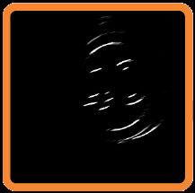
Framework(Line Drawing)
…
…
Gradient

Slide 22
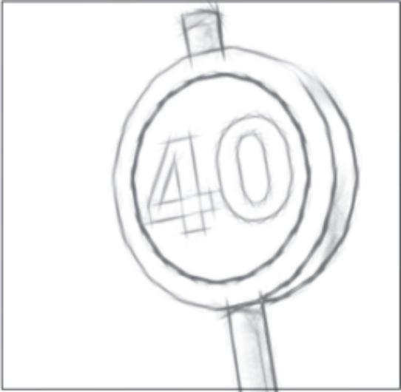
Framework(Line Drawing)
…
…
C1
C2
C4
C8
G
…
…

Slide 23
Framework(Line Drawing)

Slide 24
Framework (Tone Mapping)
Gradient
Line Drawing
Tone Mapping
Texture Rendering

Slide 25
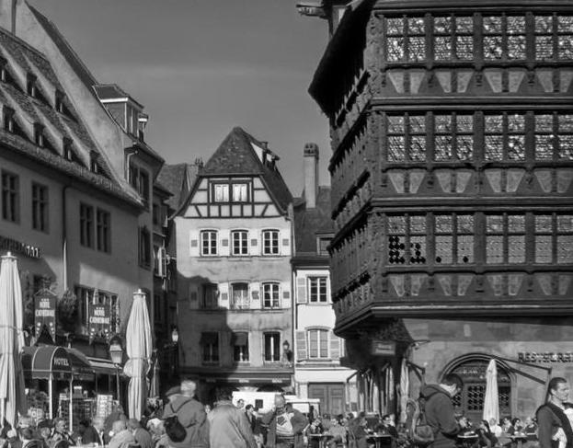
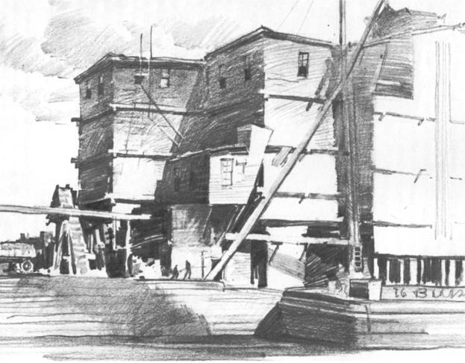
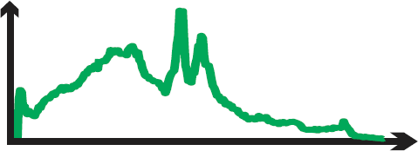
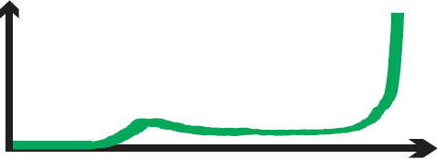
Framework (Tone Mapping)
Natural Image
Pencil Drawing

Slide 26
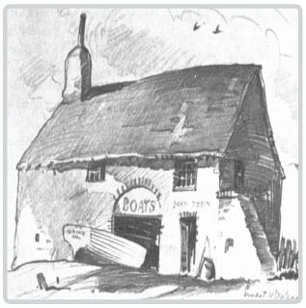
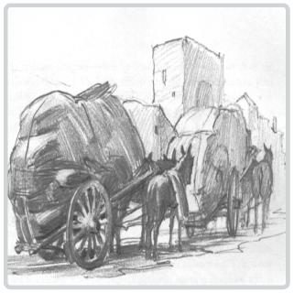
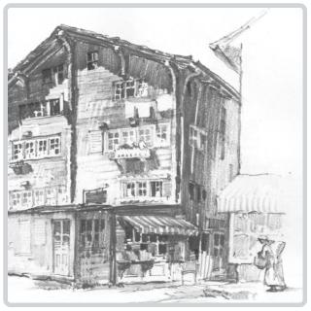
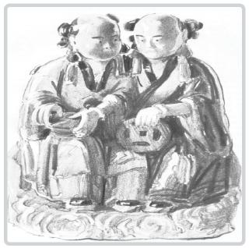
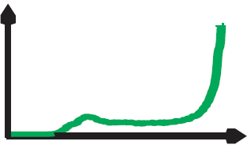
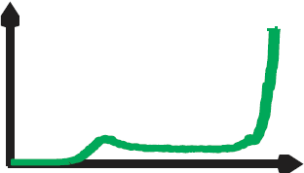
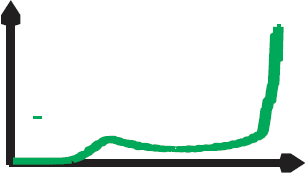
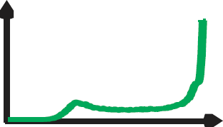
Framework (Tone Mapping)

Slide 27
Framework (Tone Mapping)

Slide 28
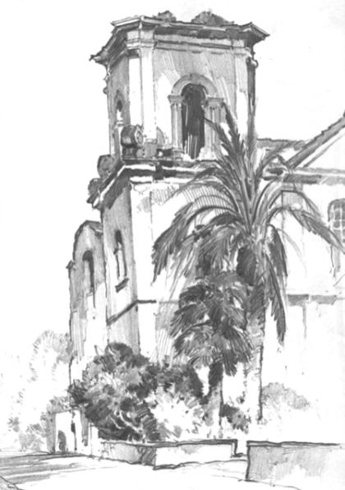
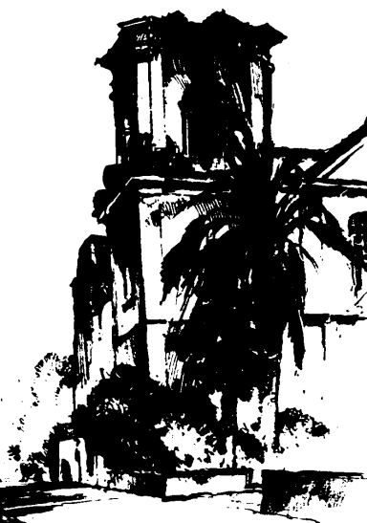
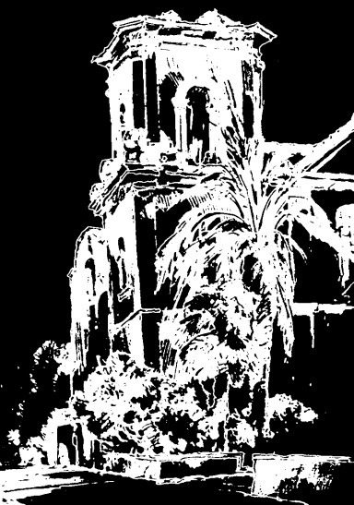
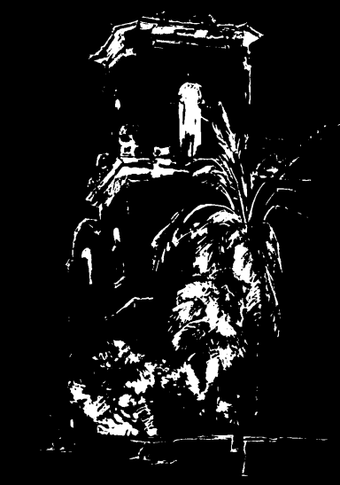
Framework (Tone Mapping)
Three-Layer Structure

Slide 29
Framework (Tone Mapping)
Bright Layer

Slide 30
Framework (Tone Mapping)
Bright Layer

Slide 31
Framework (Tone Mapping)
Mid-tone Layer

Slide 32
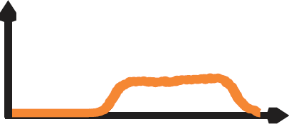
Framework (Tone Mapping)
Mid-tone Layer

Slide 33
Framework (Tone Mapping)
Dark Layer

Slide 34
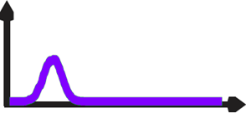
Framework (Tone Mapping)
Dark Layer

Slide 35
Framework (Tone Mapping)
Unknown Parameters
Bright Layer Mid-tone Layer Dark Layer
9 105 225 90 11

Slide 36
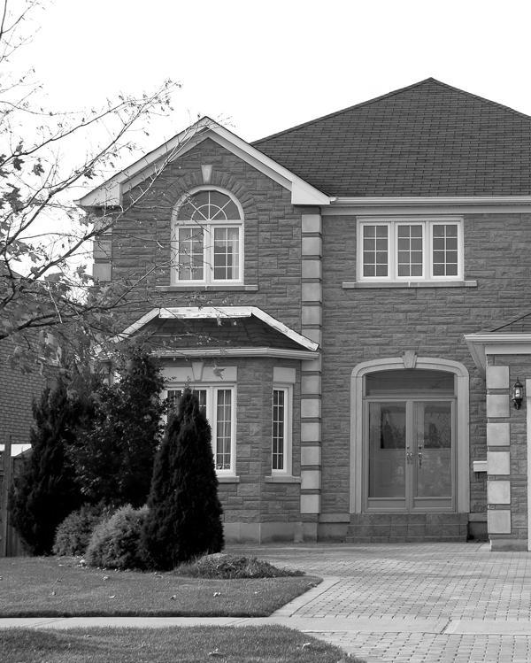
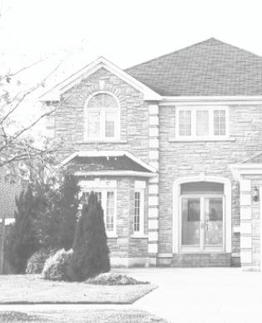
Framework (Tone Mapping)

Slide 37
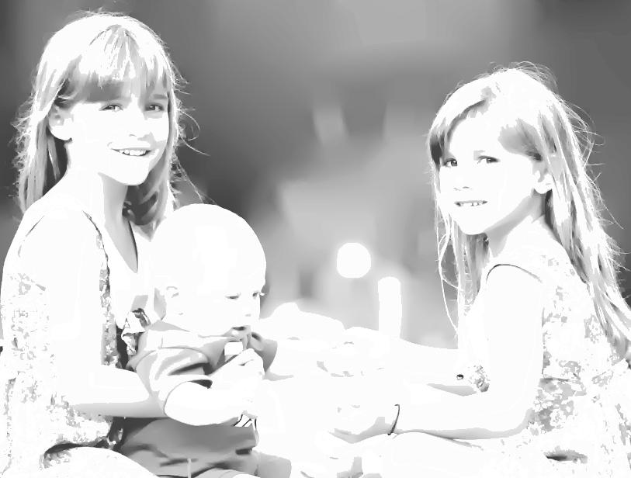
Framework (Texture Rendering)
Tonal Texture
Pencil Tone

Slide 38
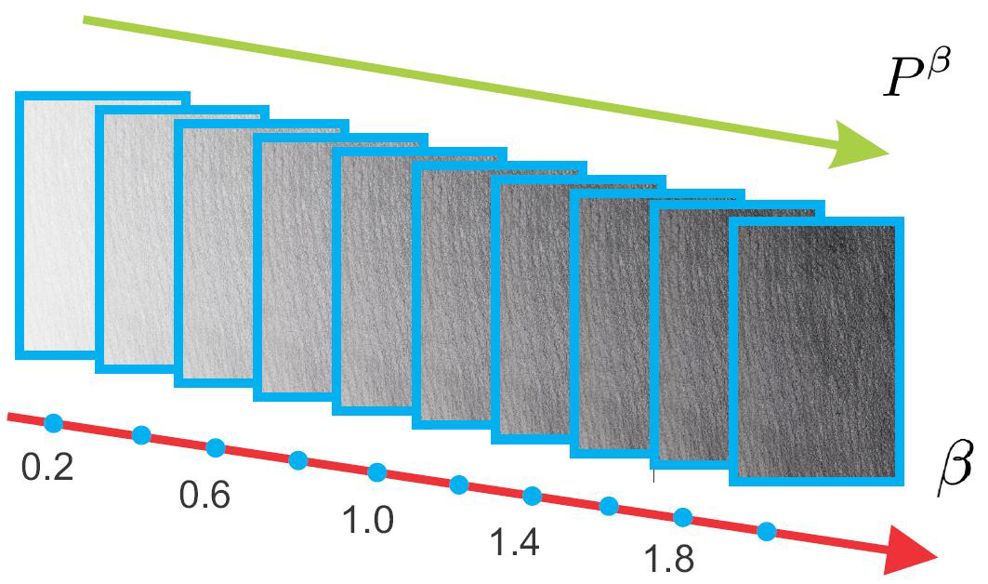
Framework (Texture Rendering)
P
Multiplication Model

Slide 39
Framework (Texture Rendering)
In multiplication model
?

Slide 40
Framework (Texture Rendering)
In multiplication model
We need to solve
Local smoothness

Slide 41
Framework (Texture Rendering)
Objective function

Slide 42
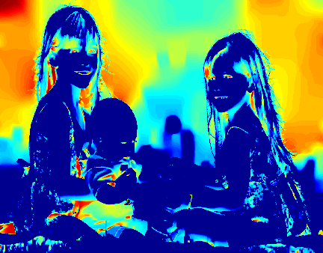
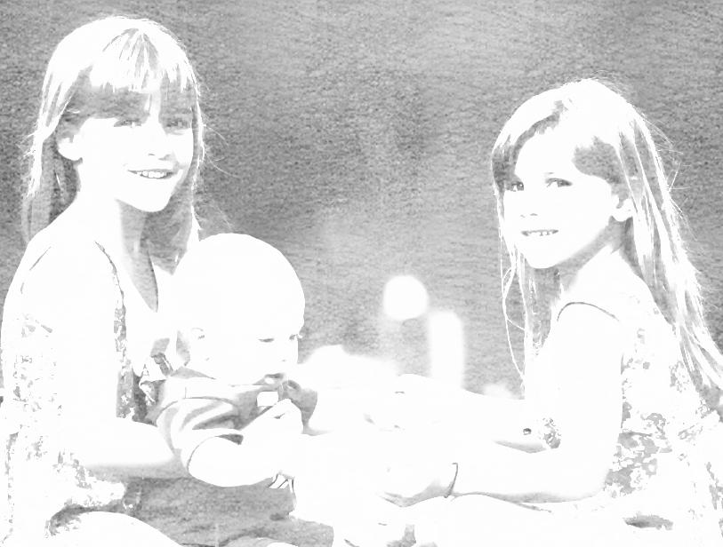
Framework (Texture Rendering)
Result

Slide 43
Framework (Combination)
Gradient
Line Drawing
Tone Mapping
Texture Rendering

Slide 44
Framework(Combination)
T

Slide 45
Framework(Combination)
S

Slide 46
Framework(Combination)
T·S

Slide 47
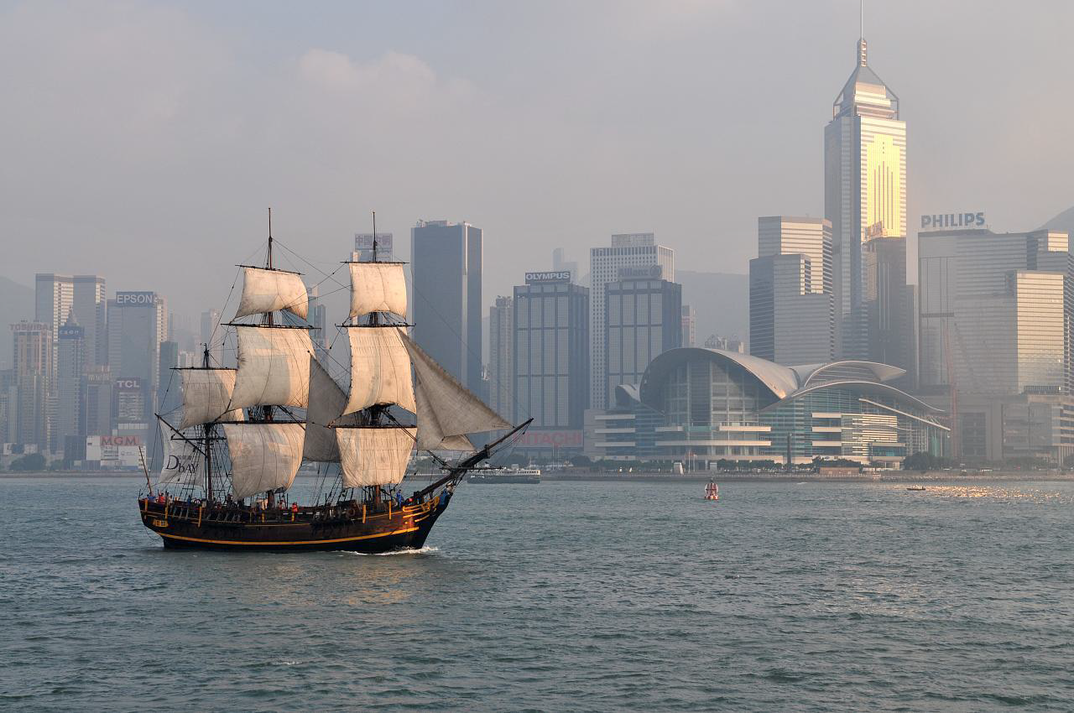
More Results

Slide 48
More Results

Slide 49
More Results

Slide 50
More Results

Slide 51
Color Pencil Drawing
Y
U
V

Slide 52
Color Pencil Drawing
Pencil Drawing
YUV->RGB
U
V

Slide 53
Color Pencil Drawing

Slide 54
Color Pencil Drawing

Slide 57
The End

